Slide 2
Concern about rms errors .3-.5degC around the coral sites – might be a lot to coral
Method 1: pattern scale each month separately (what we were doing before)
Method 2: do the pattern scaling annually, calculate a monthly downscaling fraction for each month in each grid cell, get monthly tos that way.

Slide 3
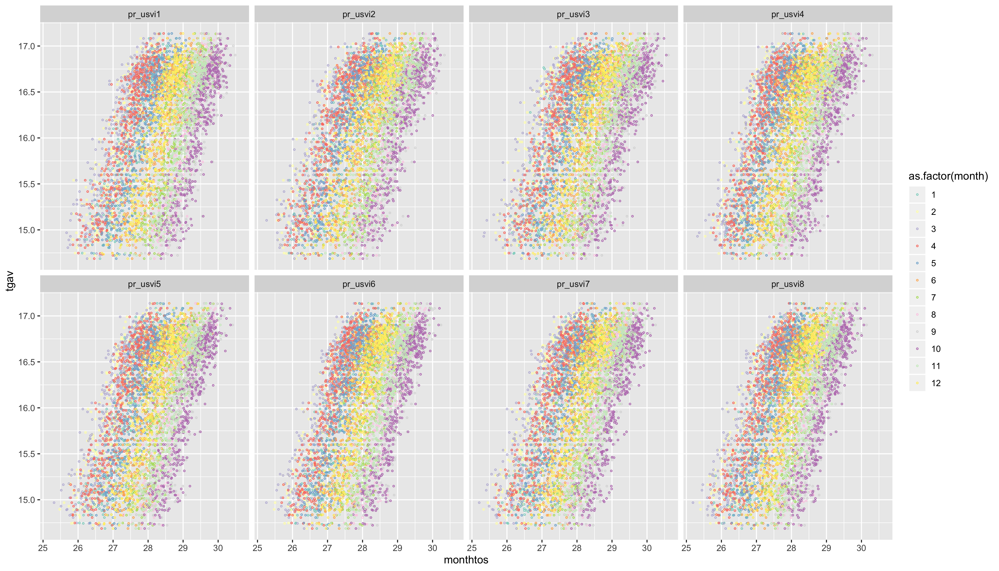
All sites comparable – monthly tos should be amenable to direct pscl

Slide 4
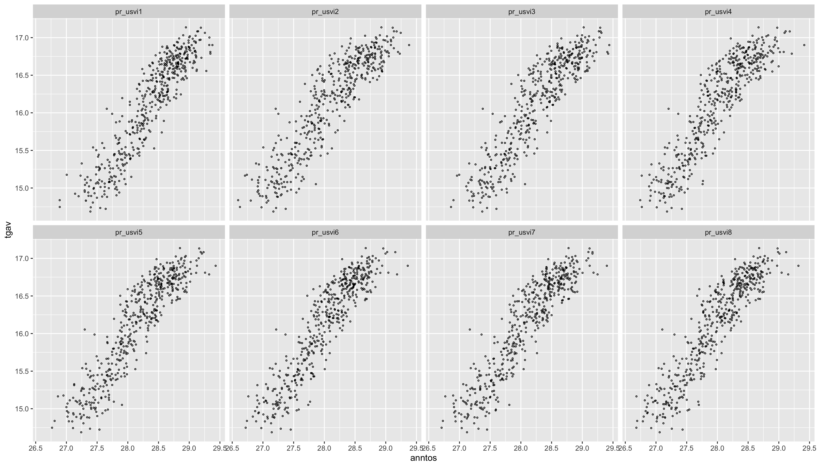
Annual tos should also be amenable to direct pscl

Slide 5
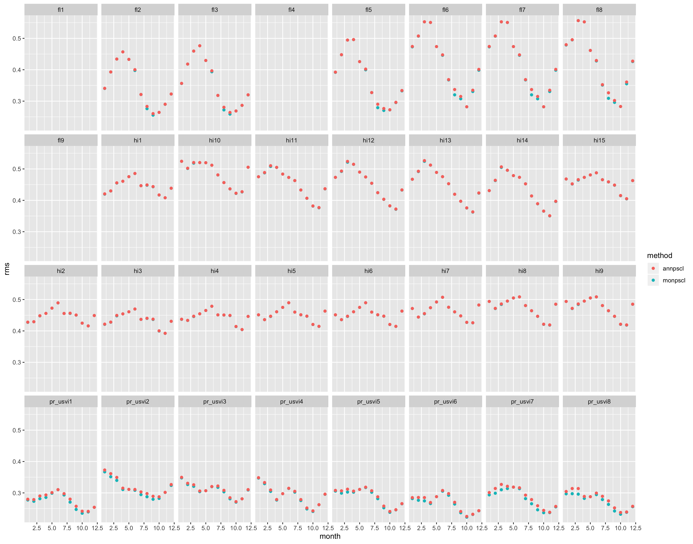
Not surprised performances so close – each can be re-written as the other.
Monthly pattern scaling more successful.
Maybe not surprising that there is a strong seasonality to the errors.
In fact, its so strong and seems to be so related to location (HI, FL, or PR) that I wonder if we can tie to any particular physical phenomena.

Slide 6
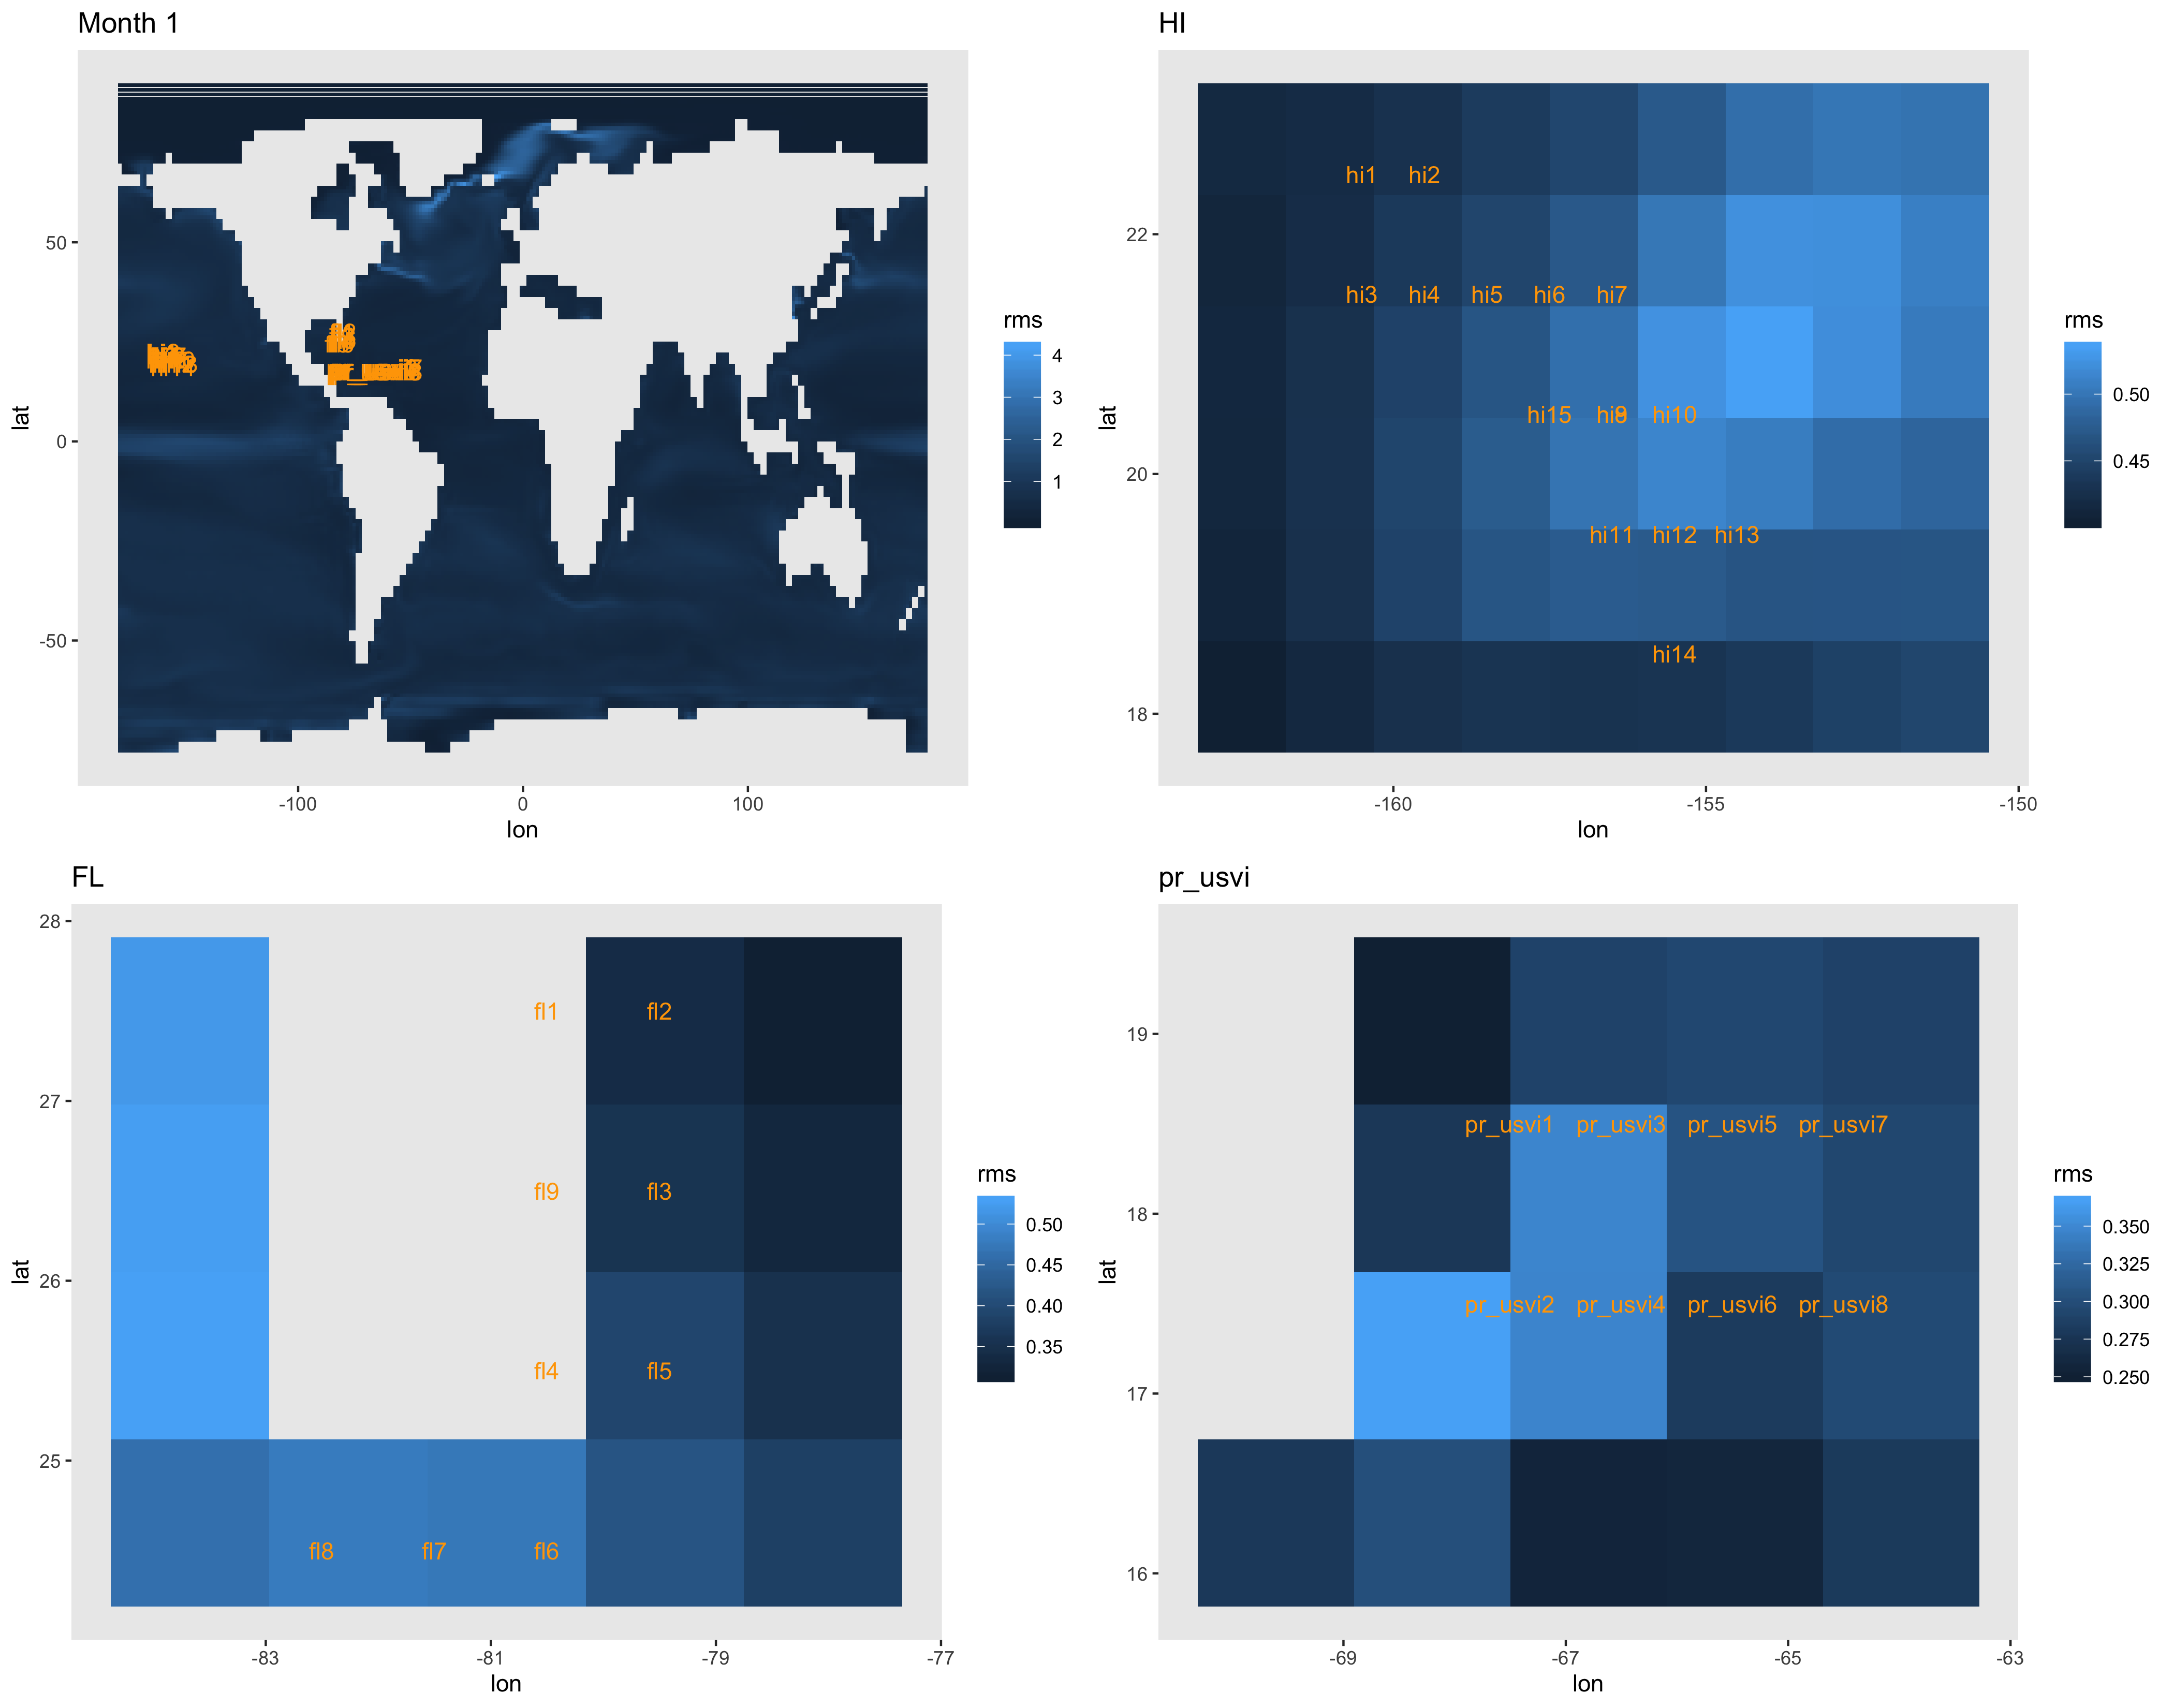

Slide 7
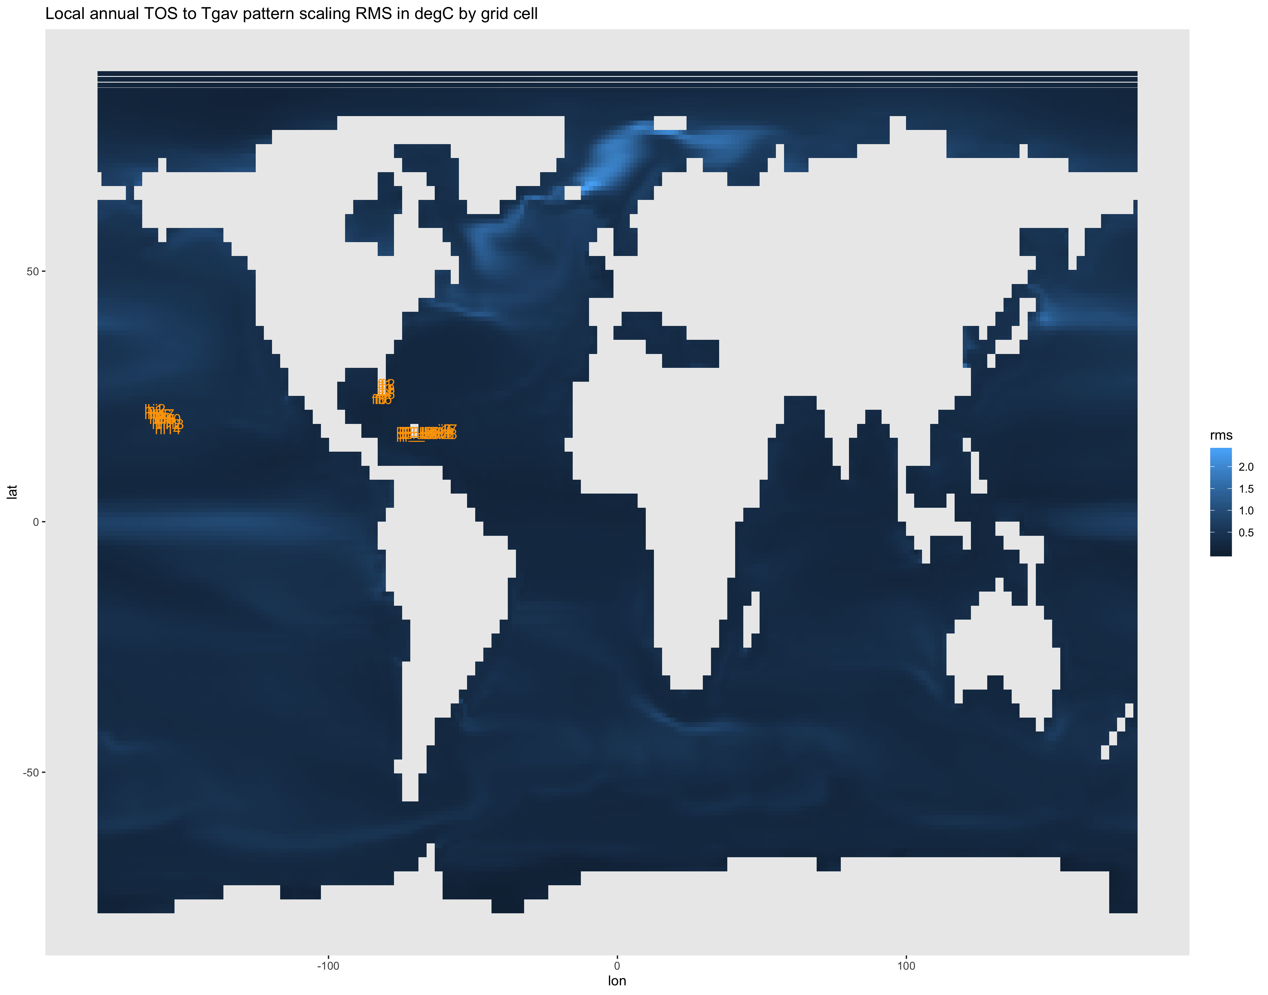
Notes:
Note that the RMS similarities is specifically for those sites - the errors over the currents are lower for annual than they are in most months – did NOT do the monthly fraction downscaling for every grid cell and check those maps.

Slide 8
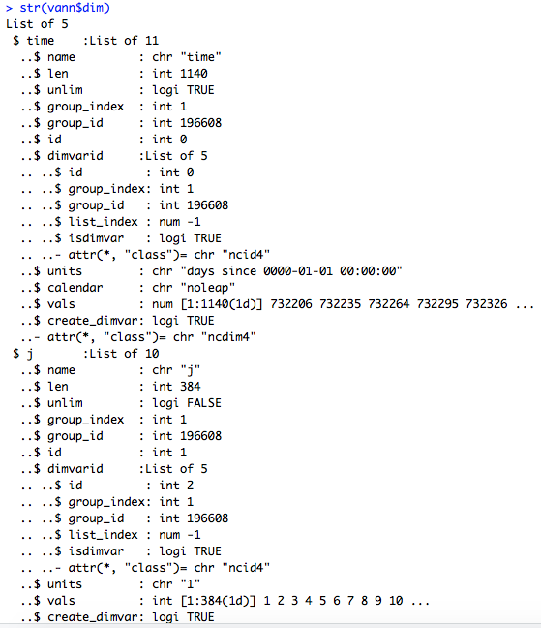
Cesm1-can5 rcp 4.5
All 3 TOS realizations lon/lat dimension names (i, j) and are just indexed 1, 2, 3,… .
Tried to guess which was which, but this is a mess and I couldn’t get it to work.
NEED the cleaned ETH data Claudia wants to port over.
Had the same problem with IPSL-CM5A-LR, NorESM1-ME
> names(vann$dim)
[1] "time" "j" "i" "bnds" "vertices"

